Slide 1
Traffic Rule Violation Detection System at Red Light
Presenter: Zainab Saleem

Slide 2
What?
Problem
At Red Light, Rule is that all vehicles should stop behind stop line.
Solution
Many people break this rule, which cause accidents and other causalities.
I have developed a system, that will use Basic Image Processing Techniques to detect which vehicles are breaking stop line rule.
At red light, camera will start take pictures, which my system will process and highlight the vehicles which are breaking rule.
Future Work
Integrate it with hardware and read the Number Plates Registration number of vehicles which are breaking rule, and create a challan.

Slide 3
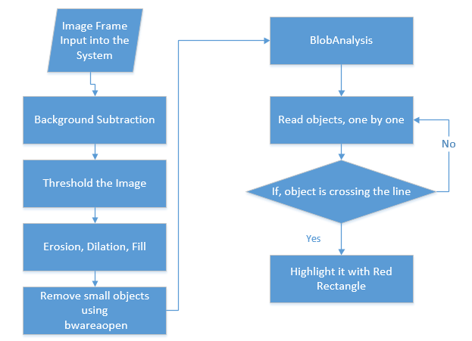
Flow Chart

Slide 4
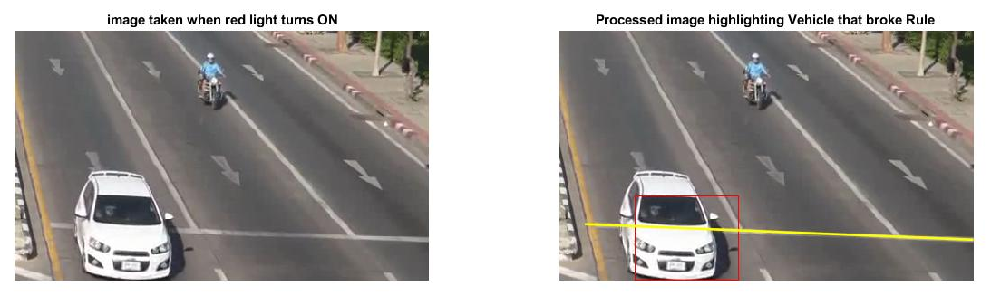
Result: Sample 1

Slide 5
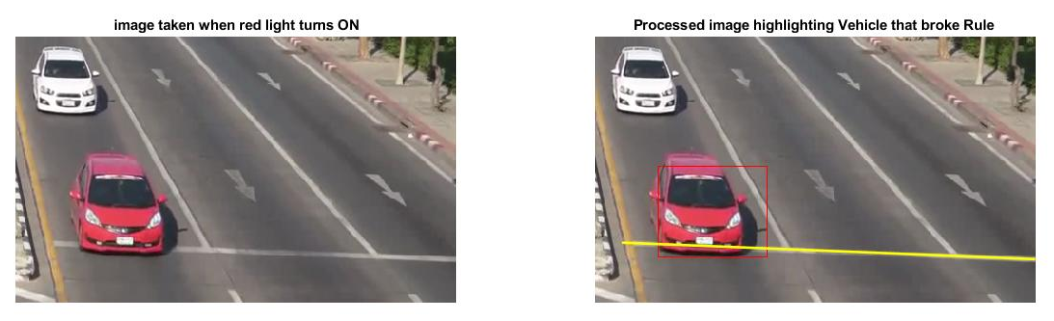
Result: Sample 2

Slide 6
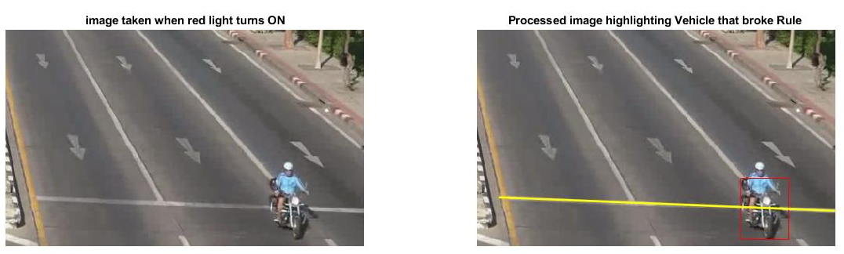
Result: Sample 3

Slide 7
Thank You!

